Slide 1
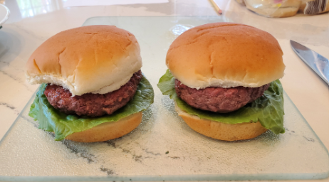

Ingredients
Basic Burger (using Lean Ground Beef)
Name: Ayesha Khan & James Brennan
Title: MSND Graduate Students
Ground Beef Burgers
1 lb. 80/20 ground beef
1 lb. 96/4 ground beef
12 oz. enriched wheat buns
Romaine lettuce (cut to 10cm [4 in.]
in diameter)
½ tsp sea salt
½ tsp ground black pepper
Total Yield: 8
Total Time: 20 minutes
In general, lean meat refers to cuts of chicken, beef, pork
and turkey that have been trimmed of visible fat.
Selecting lean meats keeps saturated fat intake within recommendations and lowers risk of chronic illnesses.
Grocery stores sell a wide variety of ground meats with varying fat content. Lean ground beef patties are great substitutions in burger recipes that are commonly consumed by children, teens, and adults alike. This simple burger recipe uses both 80/20 and 96/4 ground beef to test their sensory differences.
Equipment
Plate, cast iron flat-top cooking surface, spatula, cutting board, knife, small mixing bowl
For more recipes, tips and information contact jamesbrennan@kings.edu & ayeshakhan@kings.edu

Slide 2
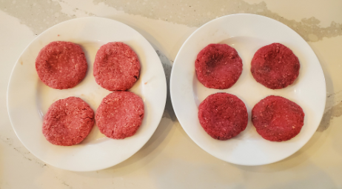
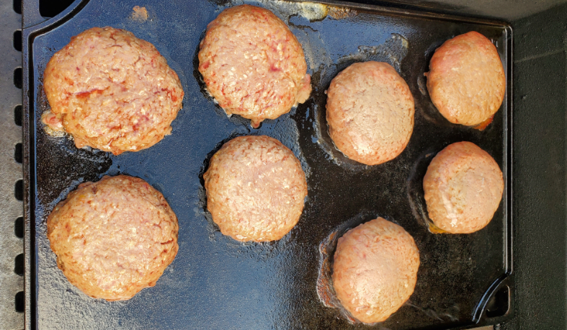
Step-by-step Instructions
Basic Burger (using Lean Ground Beef)
Name: Ayesha Khan & James Brennan
Title: MSND Graduate Students
Coordinating Photos
For each 1 lb. of ground beef you prepare, create four circular patties. Patties are to be a mass of 113 g and be a height of 1.8-2.0 cm. Place patties on a flat dish and put aside. Keep the beef varieties separate from each other
Mix salt and pepper together, and sprinkle ¼ of salt/pepper blend on each patty.
Using a flat top, cast iron surface, preheat the grill to 204ºC (400ºF). Once temperature has been achieved, allow to heat for 10 minutes.
Raw burger patties should be evenly placed on the grill surface and the lid closed. Allow to cook on one side for 6 minutes, then flip. After 4 minutes, check the temperature. Cook to 68ºC (155ºF). Immediately remove, place into a glass container and cover. Allow to rest for 5 minutes before creating a hamburger sandwich.
Place cooked burger patty on top of bottom half of bun, add lettuce piece, then top of bun.
For more recipes, tips and information contact jamesbrennan@kings.edu & ayeshakhan@kings.edu

Slide 3
NOTES FOR USING THE TEMPLATE
Insert YOUR contact information (mine is there as an Example).
Your Recipe Card may have a Front and a Back (2 Slides maximum)
This is a form of Nutrition Education, so you need to adhere to all principles of Readability, Visual Elements, etc. You must complete the DANEH Form and answer the Recipe Qs.
A Nutrition Label / Nutrient Analysis does NOT need to go on the Recipe card. If you would like to include nutrition information, be judicious in what you include and why you are including it. It can be included in a Text Box.
Be sure you have no Grammar, Spelling, Other mistakes.
Here is a Description of this Assignment.

