Slide 1

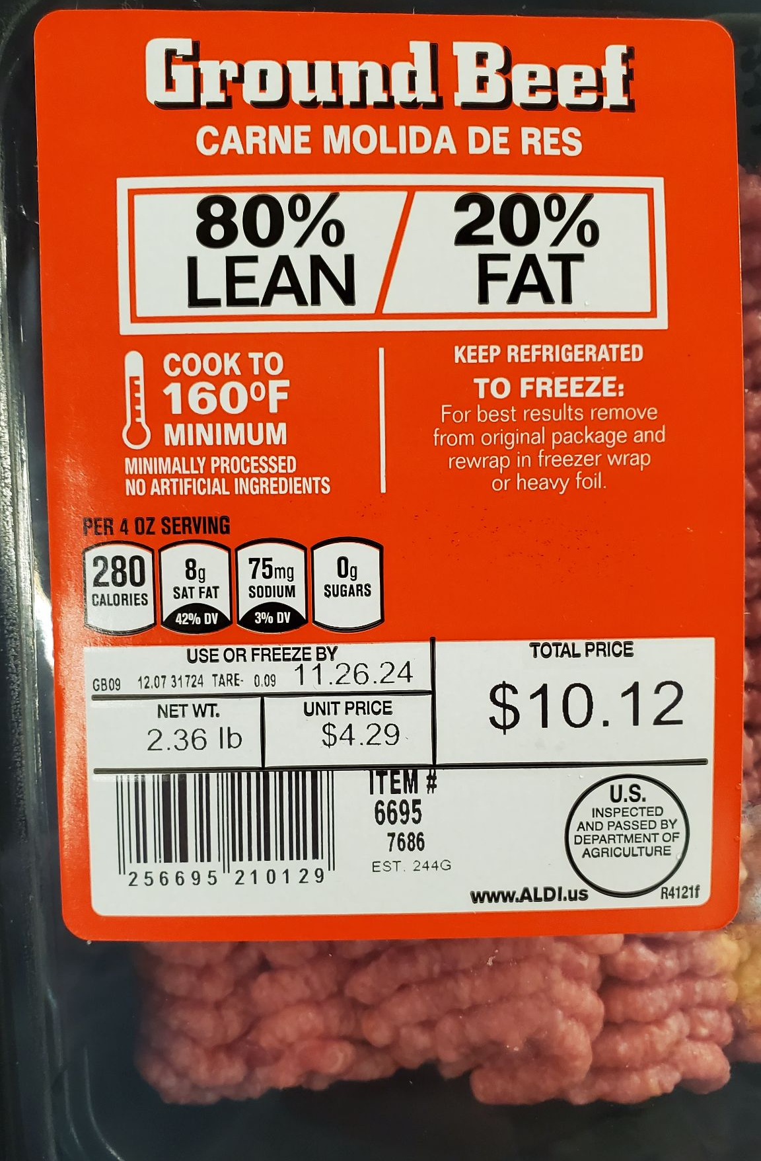
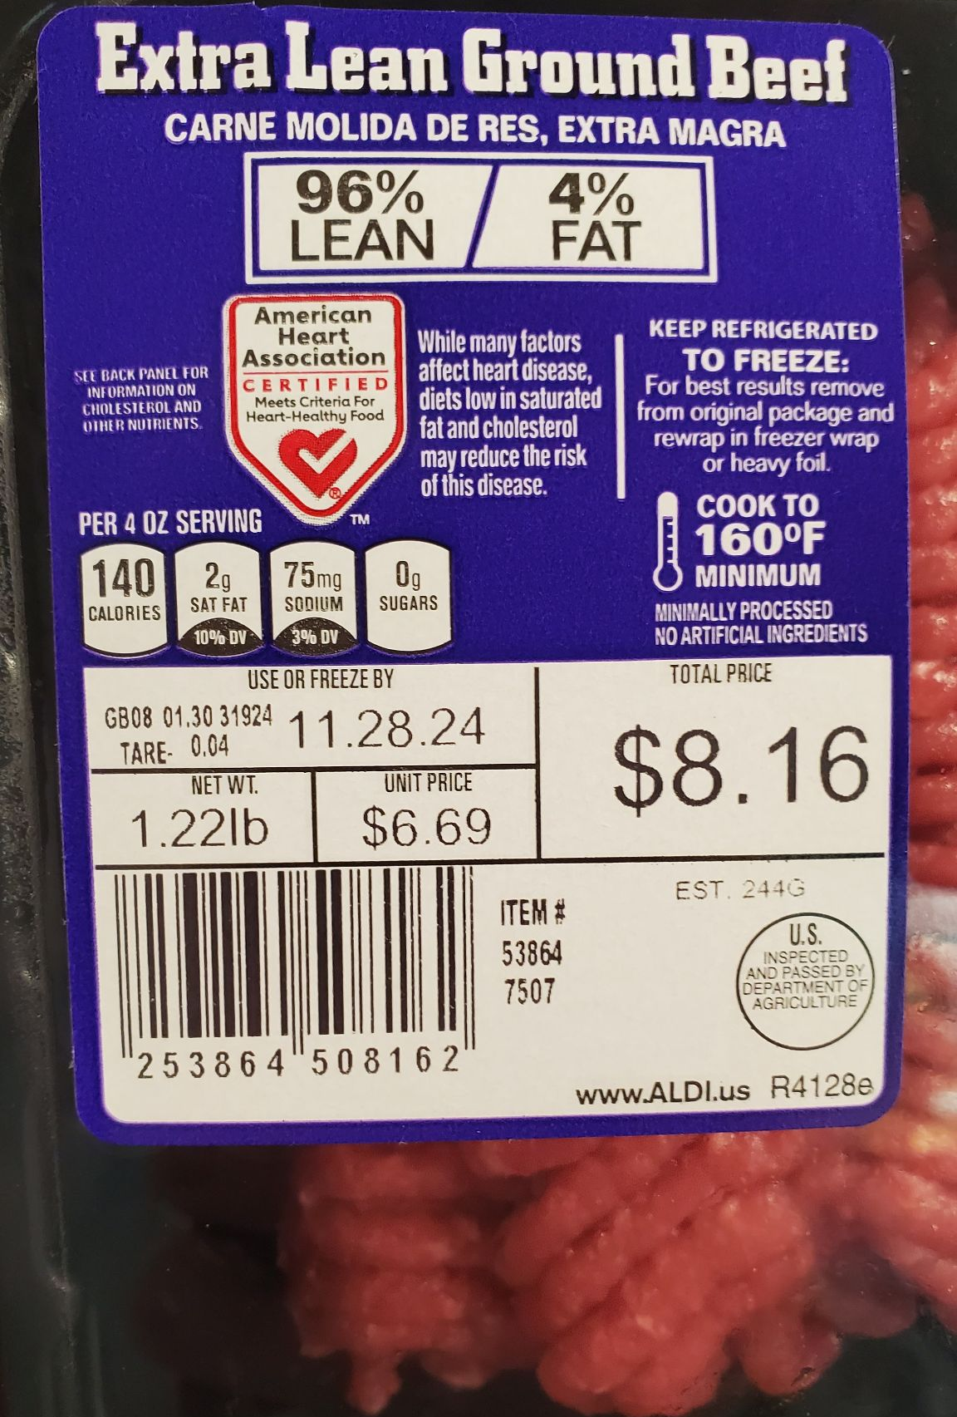
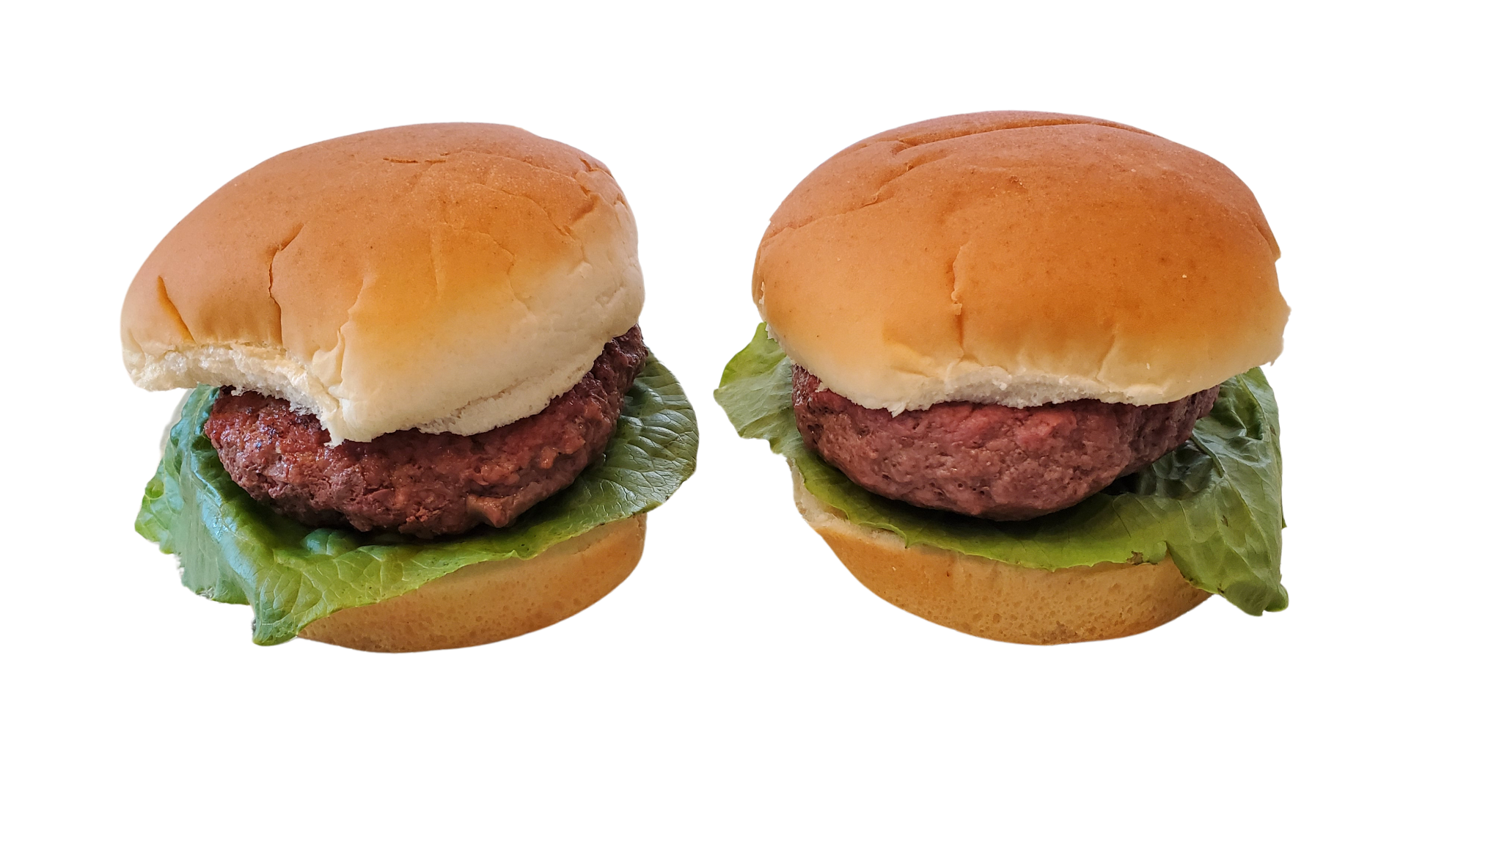
The Effects of Ground Beef Leanness on Hamburger Juiciness and Consumer Ability to Differentiate
Ayesha Khan & James Brennan
ND608 - Principles of Food
Notes:
James

Slide 2
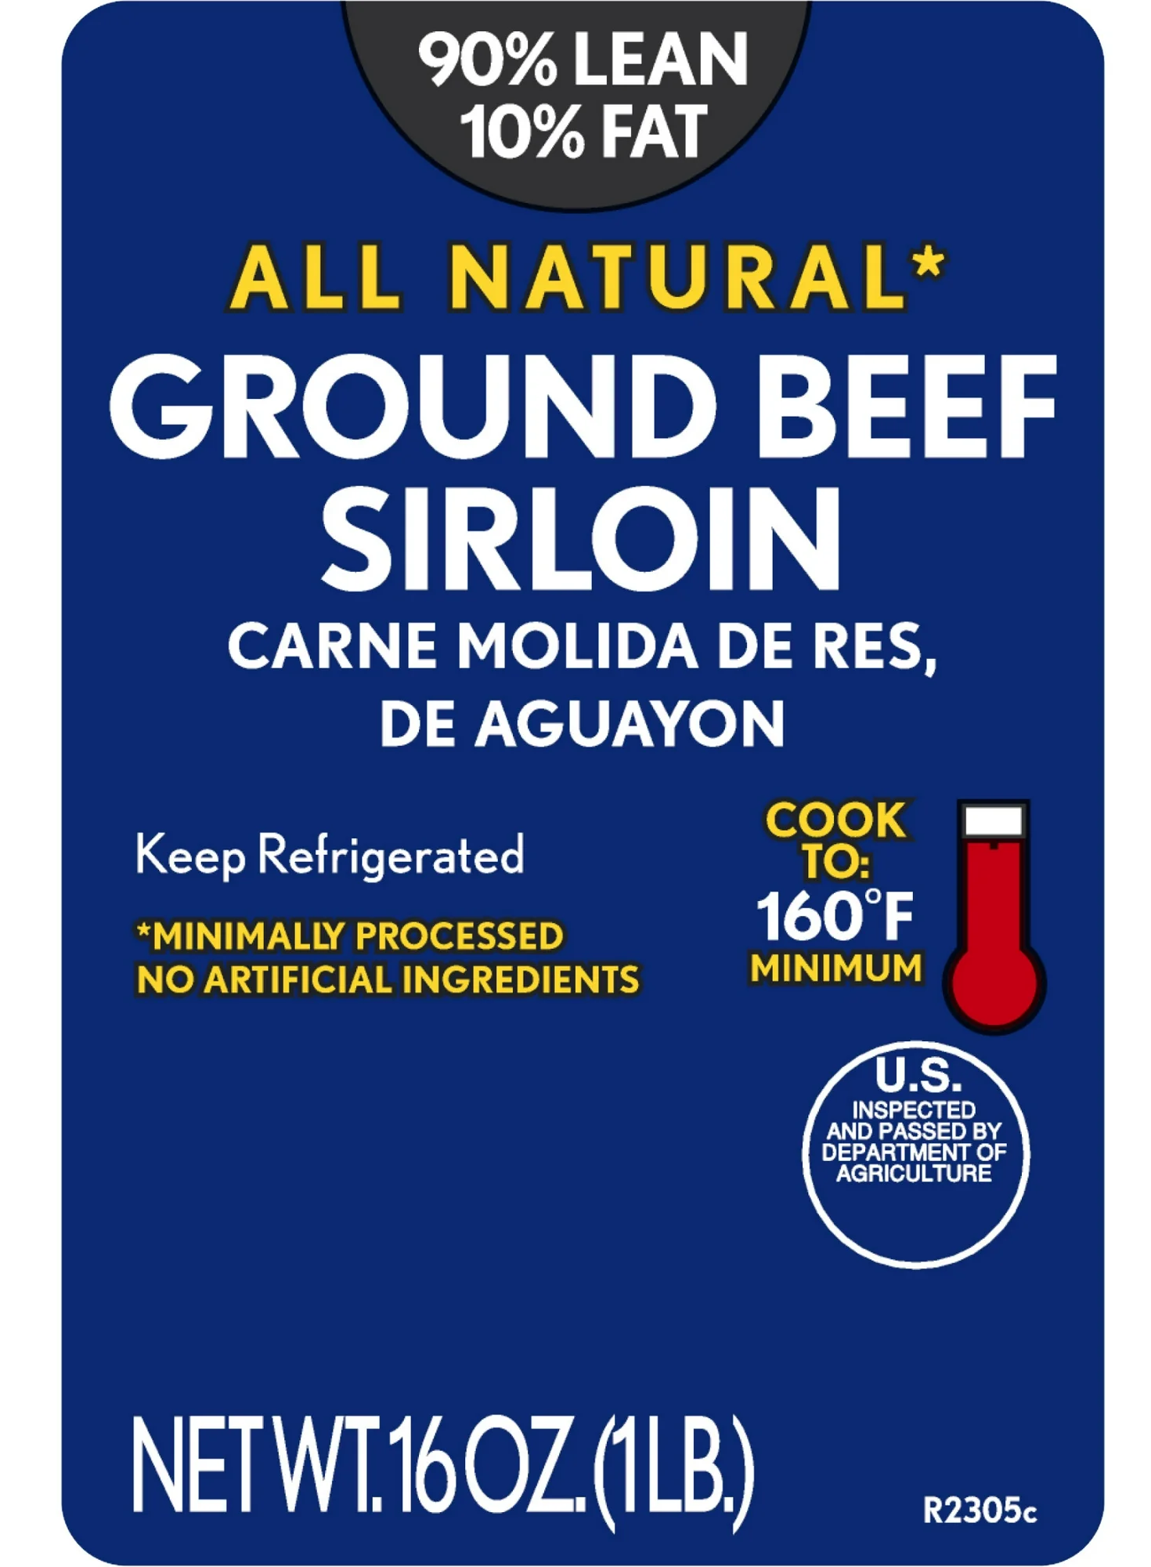
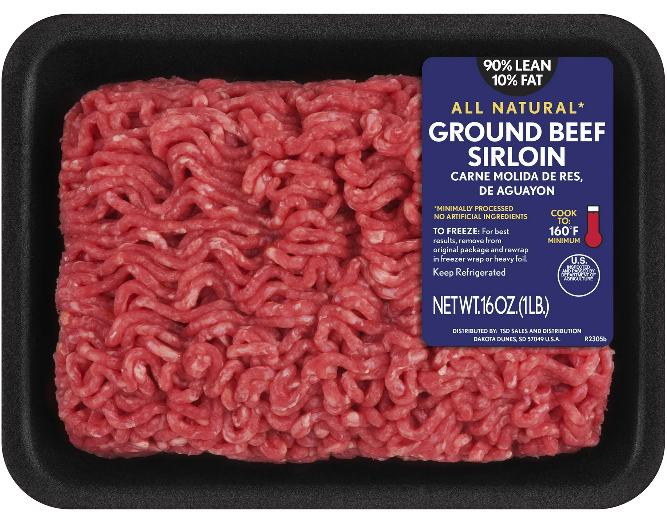
Introduction & Background
Lean meat intake has increased over the years, due to raised awareness that a high intake of fatty red meats can heighten the risk of various diseases.¹
Organizations like the CDC and USDA recommend to choose lean cuts when consuming red meat.² By selecting lean meats, one can keep their saturated fat intake within recommendations and lower their risk of chronic illnesses.
In general, lean meat refers to cuts of chicken, beef, pork and turkey that have been trimmed of visible fat. Lean tissue refers to muscle, connective tissue, vitamins, and minerals present in the meat, whereas fat refers to fat or adipose tissue.³
Fat measure is indicated in the form of a ratio or percentage on the package of the meat. For example, a ratio of 90/10 is synonymous to 90% lean and it means 90% of the mass of the meat comes from lean tissue. Grocery stores sell a wide variety of ground meats with varying fat content
Notes:
Ayesha

Slide 3
Significance
Food Cost
Ground meat costs typically follow a trend in which the leaner version of the same product is more expensive as fat has less value than protein. There are examples of exceptions to this trend though. E.g., 90/10 ground beef may come from sirloin cuts of beef, which are more expensive cuts.
Health Impacts
High saturated fat intake is associated with negative cardiovascular outcomes.¹ Animal-based foods are the primary sources of saturated fat in most human dietary approaches. Thus, choosing low-saturated meats can have a significant effect on the total amount of saturated fat that one consumes.
Food Perception
Fat and muscle tissue provide different experiences in terms of how the consumer will perceive the food. Foods with more fat have pronounced measurements of juiciness, tenderness and flavor.
Food Preparation
Different levels of fat, muscle tissue and water content create conditions that require different approaches to cooking. Leaner meats generally require less time to cook.⁴
Notes:
James

Slide 4

Objectives, Experimental Question & Hypothesis
Objective
To examine juiciness and overall sensory differences in ground beef patties with varying leanness
Lean ground meats - 80/20 & 96/4
Cooking Loss Card & Triangle Test
Experimental Question
Is there a difference in overall sensory properties and juiciness, when substituting 80/20 lean ground beef for 96/4 lean ground beef, in a simple hamburger recipe?
Hypothesis
Participants won’t be able to distinguish between the two leanness levels clearly
96/4 lean ground beef will have lower juiciness compared to the 80/20 lean ground beef due to lower fat content
Notes:
Ayesha

Slide 5
Literature Review
This review synthesized and evaluated the current research done on lean ground beef and sensory characteristics.
Lean Beef & Juiciness
N.H. Wong and J.A. Maga, conducted a study examining the effects of fat content on the sensory qualities of ground beef patties. Ground beef patties were prepared with varying levels of fat (4, 12, 20, and 30%). Trained sensory panelists assessed each treatment for variations in sensory characteristics.⁵ Results showed that higher tenderness and juiciness values were associated with higher fat levels in the patties.
Jordan MM., also conducted a study to determine the effect of various lean:fat ratios in ground beef on sensory characteristics, shelf-life, and color. The formulations were 90:10, 85:15, and 80:20 respectively.⁶ Results showed that the 90:10 treatment group received lower juiciness ratings than those in the 85:15 and 80:20 treatment groups.
Notes:
Ayesha

Slide 6
Literature Review
Lean Beef & Sensory Characteristics
Using a simulated retail display and taste sampling, Pohlman compared preferred fat content and color characteristics of labeled and unlabeled ground beef packages.⁷ In terms of sensory characteristics, results showed that participants felt no significant difference across any of the blends.
Davis et. al., comes to a similar conclusion when comparing the quality characteristics of current plant-based protein ground beef alternatives (GBA) to ground beef (GB) patties of varying fat percentages. Comparison to GBA aside, the results for GB showed that consumer sensory panelists weren’t able to detect much difference between ground beef of varying fat content.⁸ However, the trained sensory panelists were able to identify and detect differences. However, considering the consumer panelists were unable to identify any differences, they were most likely not significant enough to begin with.
Notes:
Ayesha

Slide 7
Literature Review
Conclusion
Ground meats (including ground beef) have more juiciness when there is a higher amount of fat present
Differences in sensory characteristics exist between ground beef of varying leanness levels but whether participants are able to point that out with clarity is still up in the air due to limited research
Our research had untrained participants to assess the differences between two types of ground beef patties
Our study also aimed to assess the juiciness via the water/fluid content lost during the cooking process, which is another gap the literature didn’t address.
Notes:
Ayesha

Slide 8
Materials & Methods: Basic Recipe
Ingredients
1 lb 80/20 ground beef
Enriched wheat hamburger buns
Romaine lettuce (cut to 10cm [4 in.] in diameter)
½ tsp salt
½ tsp pepper
Instructions
For each 1 lb of ground beef prepared, create four circular patties. Patties are to be a mass of 113 g and be a height of 1.8-2.0 cm. Do not handle the meat any more than is necessary to separate and create the patties. Place on a flat dish and put aside. Mix salt and pepper together, and sprinkle ¼ of salt/pepper blend on each patty.
Using a flat top, cast iron surface, preheat the grill to 204^{O}C (400^{O}F). Once temperature has been achieved, allow to heat for 10 minutes.
Raw burger patties should be evenly placed on the grill surface and the lid closed. Allow to cook on one side for 6 minutes, then flip. After 4 minutes, check the temperature. Cook to 68^{O}C (155^{O} F). Immediately remove, place into a glass container and cover. Allow to rest for 5 minutes before creating a hamburger sandwich.
Place cooked burger patty on top of bottom half of bun, add lettuce piece, then top of bun.
Notes:
James

Slide 9
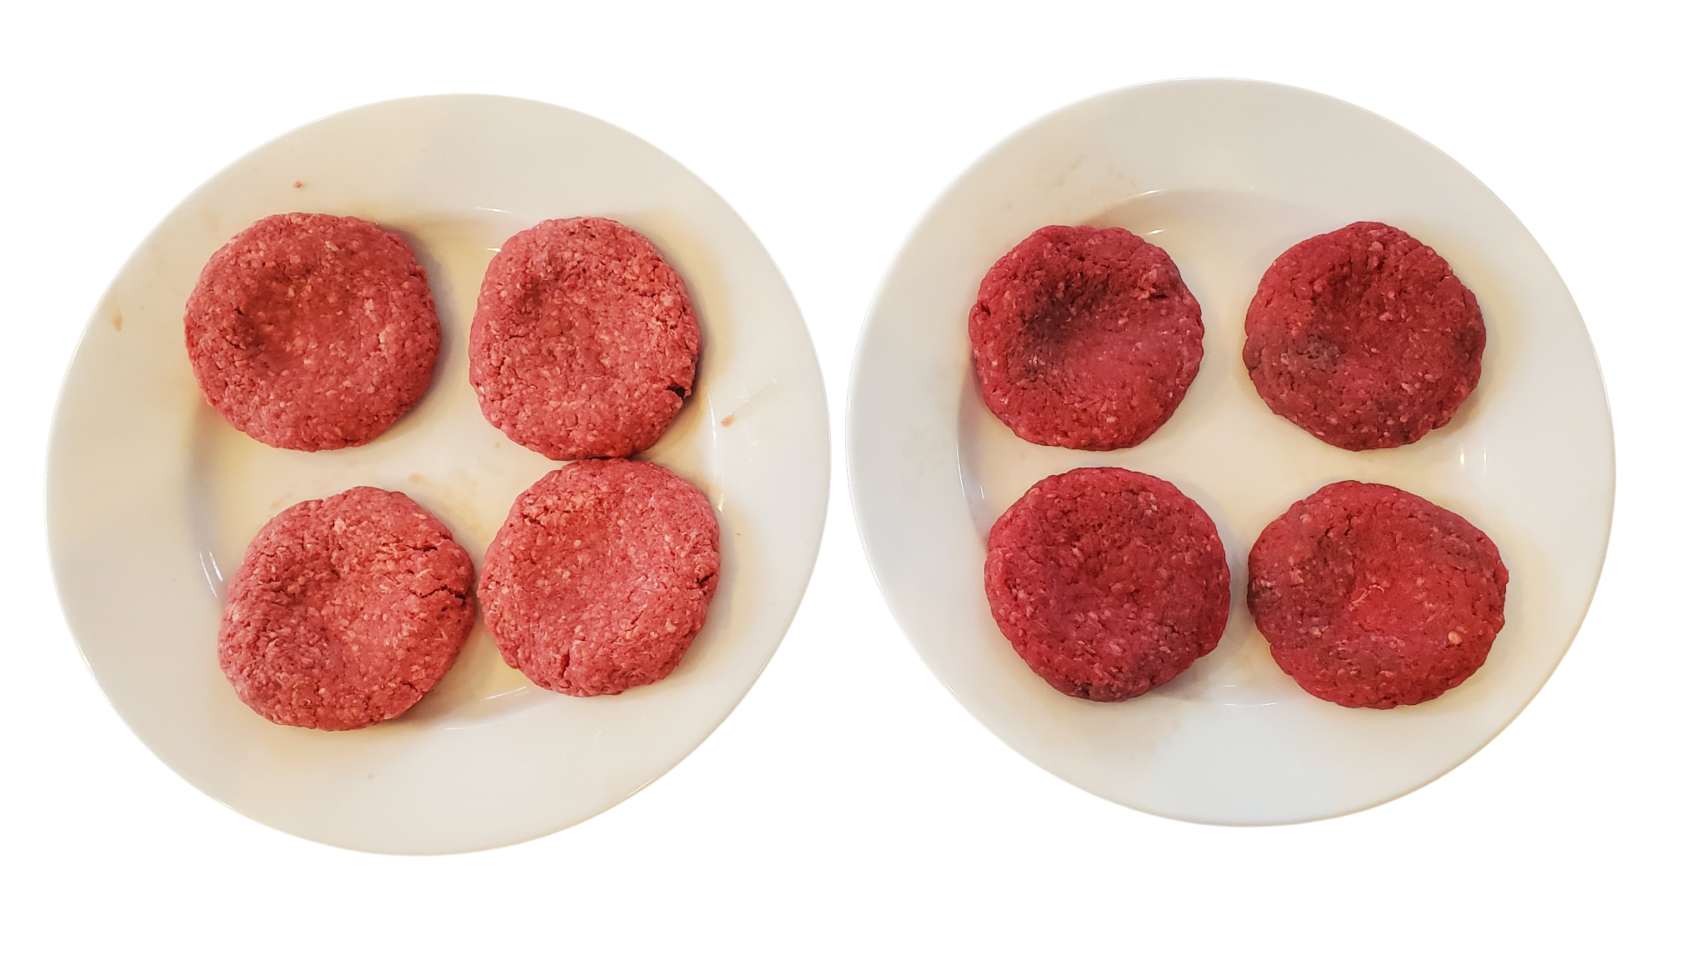
Materials & Methods: Variations and Evaluations
Variations
The basic recipe was used for four (4) 80/20 lean ground beef hamburgers. And also:
Four (4) 96/4 lean hamburgers
Evaluations
To assess juiciness:
Cooking Loss Test
To assess consumer ability to differentiate between 80/20 and 96/4 lean ground beef:
Triangle Test
Notes:
James

Slide 10
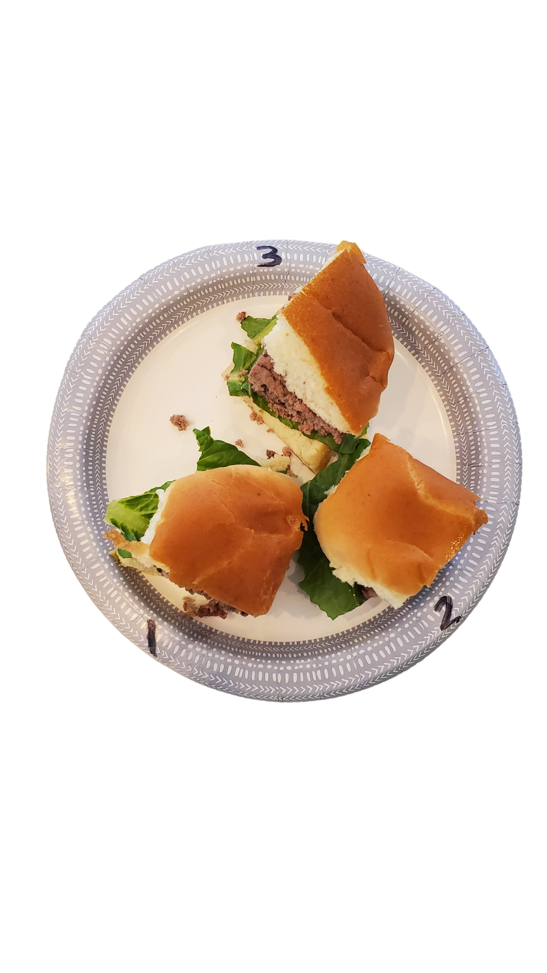
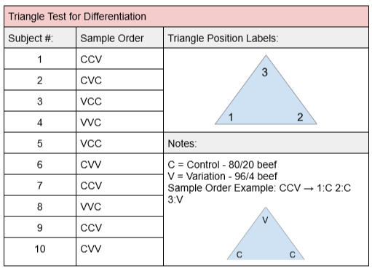
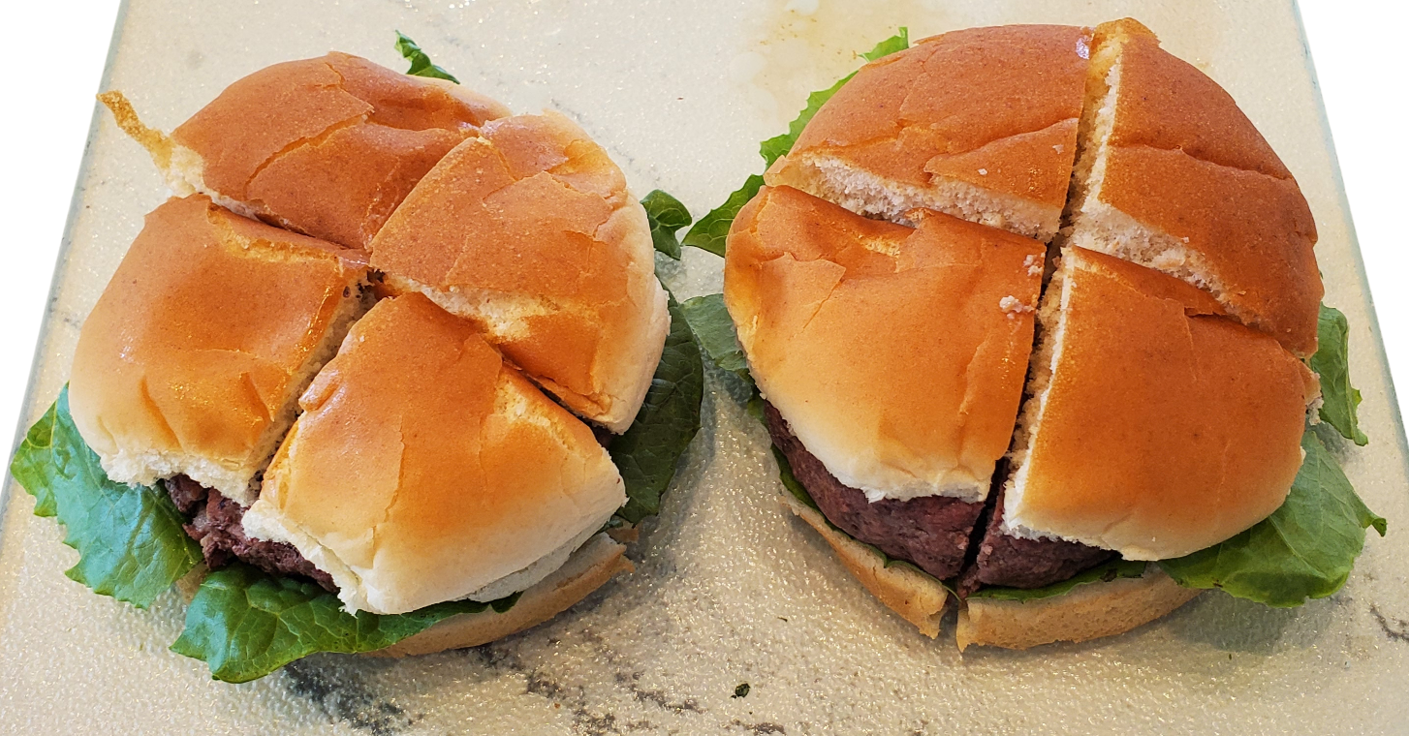
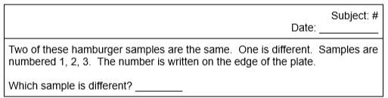
Materials & Methods: Triangle Test
Figure 1.
Subjective Evaluation: Ability to differentiate
Assemble patties into hamburger sandwiches following recipe instructions. Then, cut each hamburger into four even-sized quarters.
Each subject will receive 3 quarters (2 of one variation, 1 of the other) in a randomly assigned order, shaped like a triangle. See Figure 1 for subject order.
Each subject's samples will be on a paper plate, with the numbers 1, 2, 3 written off of the food-touching-surface. Subjects will use the scoring card to determine which sample is different from the other two samples (Fig. 2).
Figure 2.
Notes:
James

Slide 11
Materials & Methods: Triangle Test
SEE SPEAKER NOTES :)
Figure 1.
Subjective Evaluation: Ability to differentiate
Assemble patties into hamburger sandwiches following recipe instructions. Then, cut each hamburger into four even-sized quarters.
Each subject will receive 3 quarters (2 of one variation, 1 of the other) in a randomly assigned order, shaped like a triangle. See Figure 1 for subject order.
Each subject's samples will be on a paper plate, with the numbers 1, 2, 3 written off of the food-touching-surface. Subjects will use the scoring card to determine which sample is different from the other two samples (Fig. 2).
Figure 2.
Notes:
This slide is just to show what’s under the pictures. Those pictures will be animated and appear/disappear during the presentation. This slide will be hidden.

Slide 12
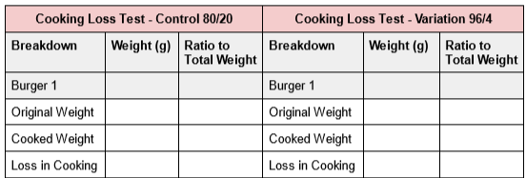
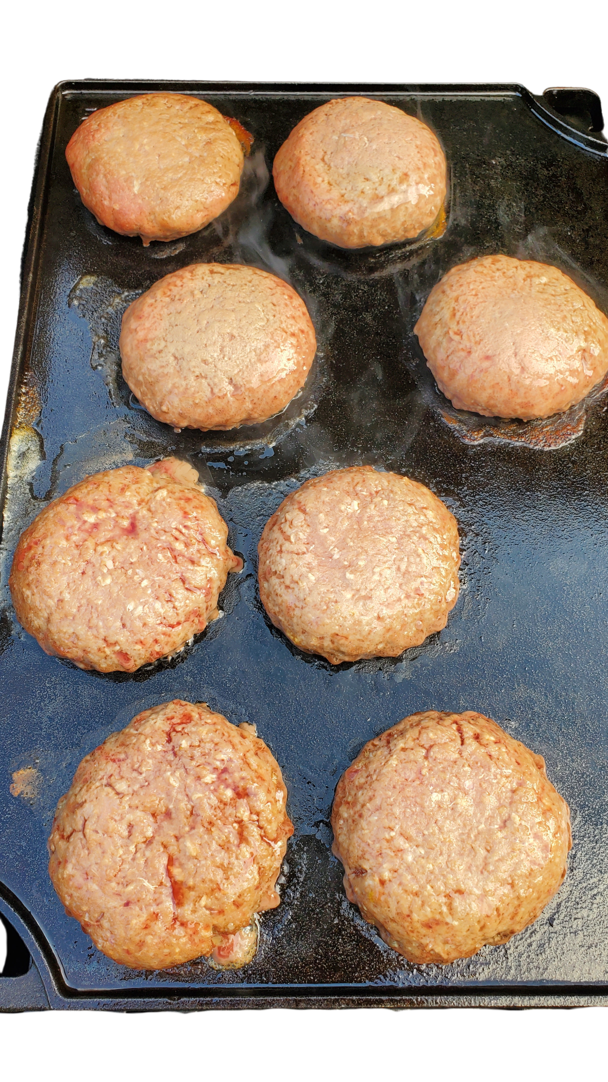
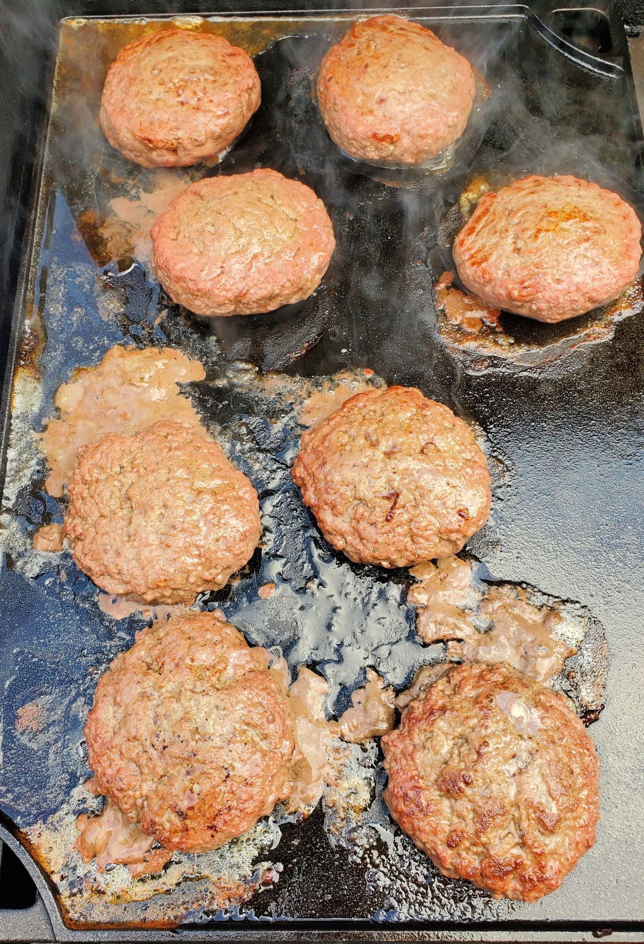
Materials & Methods: Juiciness - Cooking Loss
Objective Evaluation: Juiciness
All beef patties will be made and cooked to recipe specifications. Be sure each patty is exactly 113g while in the raw state prior to cooking.
After cooking and 5 minutes of resting, weigh each patty individually and record weight.
Complete cooking loss card to assess difference in pre/post-cooking states.
Statistical analysis: unpaired t-test to examine relationship between amounts of cooking loss between varieties
Notes:
James

Slide 13
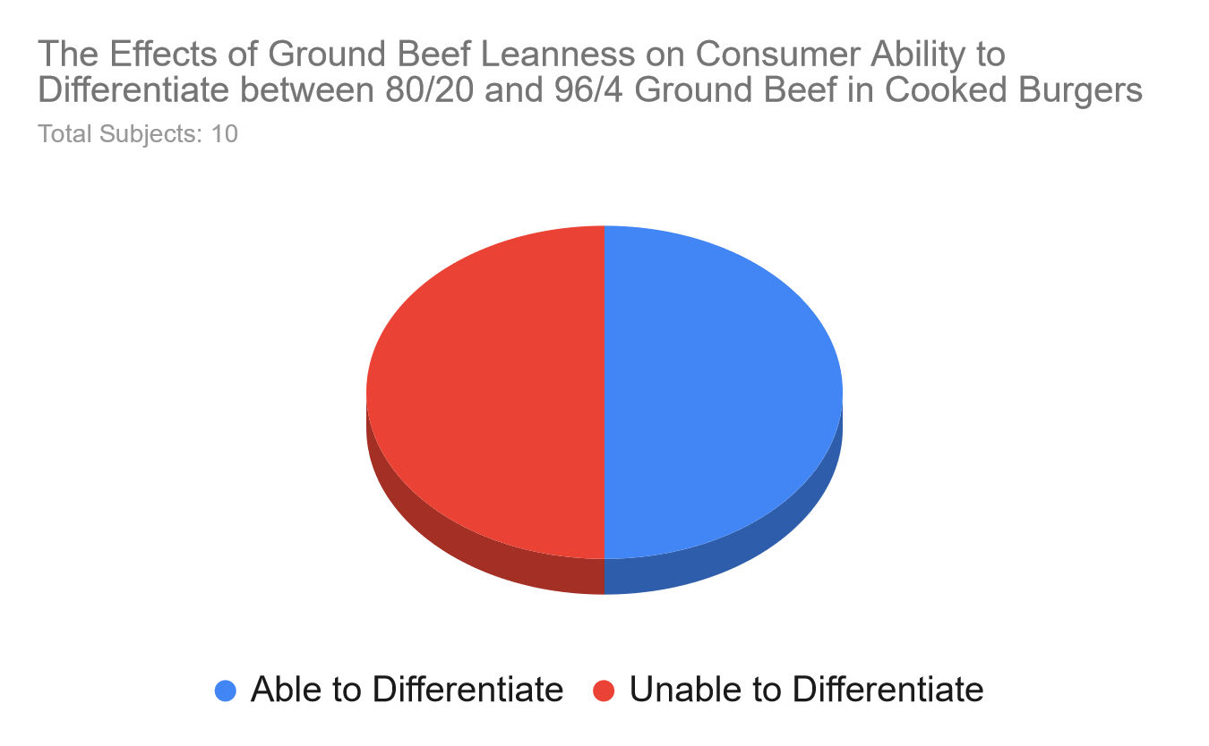
Results: Ability to Differentiate - Triangle Test
Notes:
James

Slide 14
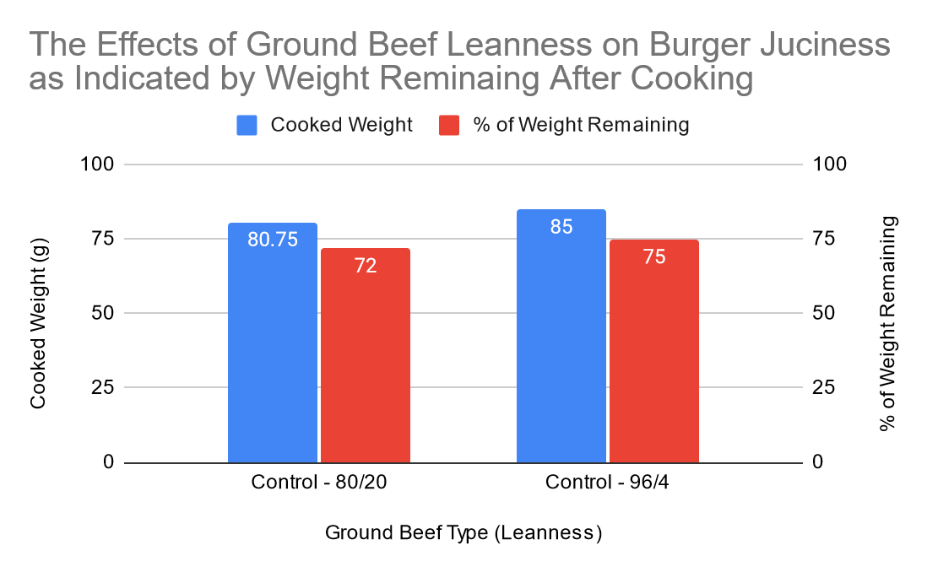
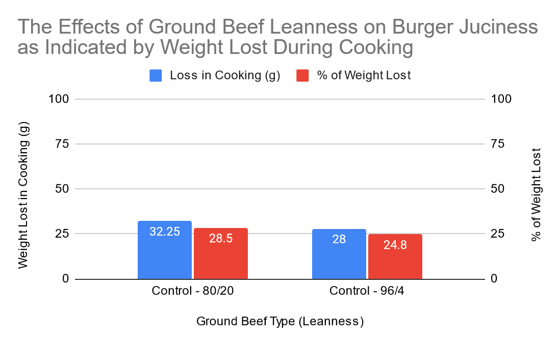
Results: Juiciness - Cooking Loss
The Effects of Ground Beef Leanness on Burger Juiciness as Indicated by Weight Remaining After Cooking
Ground Beef Type | Cooked Weight | % of Weight Remaining
Control - 80/20 | 80.75 | 72
Variation - 96/4 | 85 | 75
The Effects of Ground Beef Leanness on Burger Juiciness as Indicated by Weight Lost During Cooking
Ground Beef Type | Loss in Cooking (g) | % of Weight Lost
Control - 80/20 | 32.25 | 28.5
Variation - 96/4 | 28 | 24.8
P-value of cooking loss: 0.0596
Notes:
James

Slide 15
Discussion
Aim of the study was to assess the juiciness and overall sensory differences in ground beef patties with varying leanness.
50% of the participants were able to clearly differentiate between the 80/20 and 96/4 ground beef patties in cooked burgers. However, the other 50% could not distinguish between the two beef patties of varying leanness levels.
There was a positive association between higher fat in ground beef and increased juiciness levels (p-value of 0.0596)
Very limited research on lean:fat ground beef ratios and consumers’ ability to differentiate
Further research needs to be done on how different cooking methods can influence sensory characteristics of ground meats with varying leanness levels
Hypothesis on consumers’ ability to differentiate - unanswered by our study due to 50/50 results
Notes:
Ayesha

Slide 16
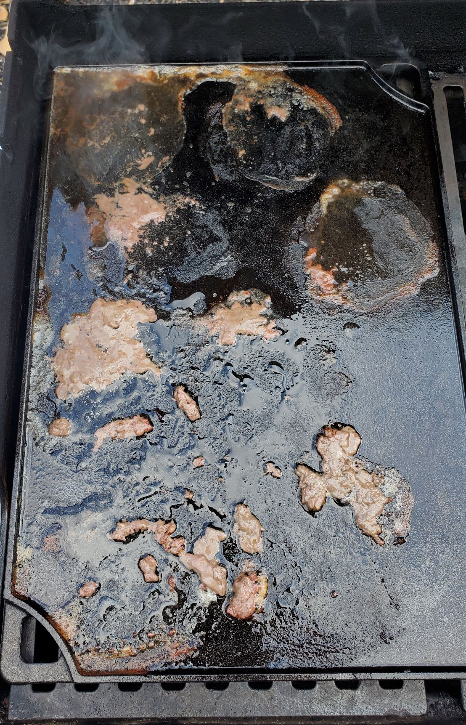
Discussion: Strengths & Limitations
Strengths
Our study addressed a few gaps in literature,
Juiciness was assessed between two types of lean beef patty variation via the water/fluid content lost during the cooking process
Untrained participants were used to assess the differences between two types of ground beef patties with varying leanness levels.
Addresses the importance of personal preference in making healthy food choices.
Limitations
Sample:
Small size (10), varied in age/experience with food, and knowledge of study
Dripping collection:
Uneven surface of grill caused drippings to pool together → unable to assess drippings composition
Notes:
This slide is just to show what’s under the pictures. Those pictures will be animated and appear/disappear during the presentation. This slide will be hidden.

Slide 17
Discussion: Strengths & Limitations
Strengths
Our study addressed a few gaps in literature,
Juiciness was assessed between two types of lean beef patty variation via the water/fluid content lost during the cooking process
Untrained participants were used to assess the differences between two types of ground beef patties with varying leanness levels.
Addresses the importance of personal preference in making healthy food choices.
Limitations
Sample:
Small size (10), varied in age/experience with food, and knowledge of study
Dripping collection:
Uneven surface of grill caused drippings to pool together → unable to assess drippings composition
Notes:
James

Slide 18
Cost Analysis
Ground beef prices:
80/20: $4.29 per 1 lb. | $1.07 per serving
96/4: $6.69 per 1 lb. |$1.67 per serving
Other ingredient costs:
Enriched wheat hamburger buns:
  $1.65 per unit | $0.21 per serving
Lettuce:
  $3.85 per unit | $0.05 per serving
Salt:
  $2.09 per unit | $0.01 per serving
Pepper:
  $3.09 per unit | $0.02 per serving
Cost per serving:
80/20 burger: $1.37
96/4 burger: $1.97
Notes:
James

Slide 19
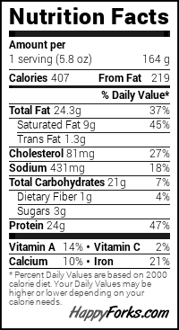
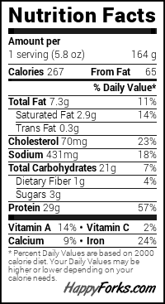
Nutrient Analysis
*96/4 ground beef was not an option on HappyForks, so the closest was selected
80/20 Lean Ground Beef
*95/5 Lean Ground Beef
Total fat, calories, and cholesterol levels are higher in the burger made with 80/20 ground beef compared to the burger made with 95/5 ground beef.
The carbohydrates; including dietary fiber and sugars remained the same in both 80/20 and 95/5 ground beef burgers.
The protein and iron levels are higher in the burger made with 95/5 ground beef compared to the one made with 80/20 ground beef.
Notes:
Ayesha

Slide 20
Conclusion
The results of the current study provide evidence that higher levels of fat in ground beef are associated with higher levels of juiciness in the meat.
While there exists differences in sensory characteristics between ground beef patties with varying levels of fat, the results of the current study indicated that an equal number of untrained participants’ could and couldn’t distinguish between the two leanness levels clearly.
These results encourage using cooking loss as a method to assess juiciness levels between ground beef patties with varying leanness levels
These results also encourage the necessity of large-scale experimental studies to accurately determine whether untrained consumers can detect sensory differences in ground beef patties with varying lean-to-fat ratios
Notes:
Ayesha

Slide 21
References
1. Wein H. Risk in Red Meat? National Institutes of Health (NIH). Published March 26, 2012. https://www.nih.gov/news-events/nih-research-matters/risk-red-meat
2. Richards L. Lean meat: Benefits and how to choose meats. www.medicalnewstoday.com. Published September 28, 2021. https://www.medicalnewstoday.com/articles/lean-meat
3. farmwayadmin. Lean Meats: Health Benefits and Diet Integration. Farmway Foods. Published March 8, 2024. https://farmwayfoods.ca/the-health-benefits-of-lean-meats-incorporating-them-into-your-diet/
4. How to cook lean beef | Washington State Magazine | Washington State University. Wsu.edu. Published 2024. Accessed December 6, 2024. https://magazine.wsu.edu/web-extra/how-to-cook-lean-beef/

Slide 22
5. Wong NH, Maga JA. The effect of fat content on the quality of ground beef patties. ScienceDirect. Published January 1, 1995. https://www.sciencedirect.com/science/article/abs/pii/S0167450106802372
6. Jordan MM. The effects of lean-to-fat ratio on the shelf life and sensory characteristics of grass-fed ground beef. Tdl.org. Published May 2022. https://asu-ir.tdl.org/items/719956b5-1552-4a18-92d3-ddde34aa5d20
7. Pohlman FW, Anthony NB, Yang FL. Effects of Labeling and Consumer Health Trends on Preferred Ground Beef Color Characteristics, Fat Content, and Palatability in Simulated Retail Display. Meat and Muscle Biology. 2017;1(3):9-9. doi:https://doi.org/10.221751/rmc2017.009
8. Davis SG, Harr KM, Farmer KJ, et al. Quality of Plant-Based Ground Beef Alternatives in Comparison with Ground Beef of Various Fat Levels. Meat and Muscle Biology. 2021;5(1). doi:https://doi.org/10.22175/mmb.12989

